Slide 1

Microsoft Dynamics GP
Affordable Care Act - Demo
Terry Heley
Microsoft Dynamics GP
Sr. Escalation Engineer

Slide 2


Dynamics GP ACA SETUP & TIPS
Insert Your Photo Here
Deb Sletmoen
Owner and President
Terry Heley
Escalation Engineer
Microsoft
theley@Microsoft.com

Slide 3


ACA - 2015
We have learned a lot over the years
It is now 2022 and the form is still here…

Slide 4
ACA Documentation
Dynamics GP U.S. Payroll - Dynamics GP | Microsoft Docs

Slide 5
ACA Documentation
Each year there is a blog for ACA of changes
2021 ACA Updates
2020 ACA Updates
2019 ACA Updates
2018 ACA Updates
2017 ACA Updates
2016 ACA Updates

Slide 6
ACA for Microsoft Dynamics GP
ACA Dynamics GP
Track by GP User Date
Ability to print complete form
Usually required to install the year-end update
Human Resource required to track
Look back period not included
Electronic filing not supported

Slide 7
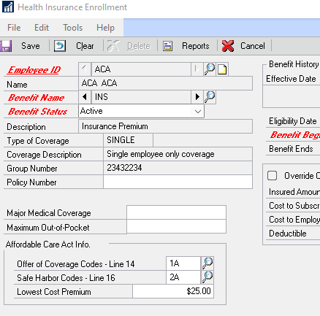
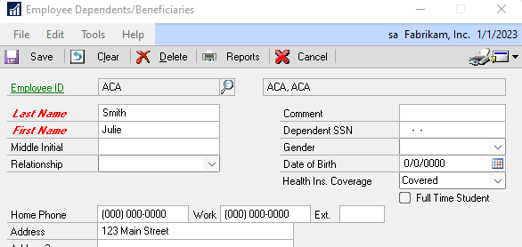
ACA Dynamics GP
None/None for Non-ACA codes
Year-End Editing
Form Printing
Lowest Cost Premium
User Date is KEY
Notes:
https://mbs.microsoft.com/customersource/northamerica/GP/learning/documentation/system-requirements/dynamicsgpresource

Slide 8
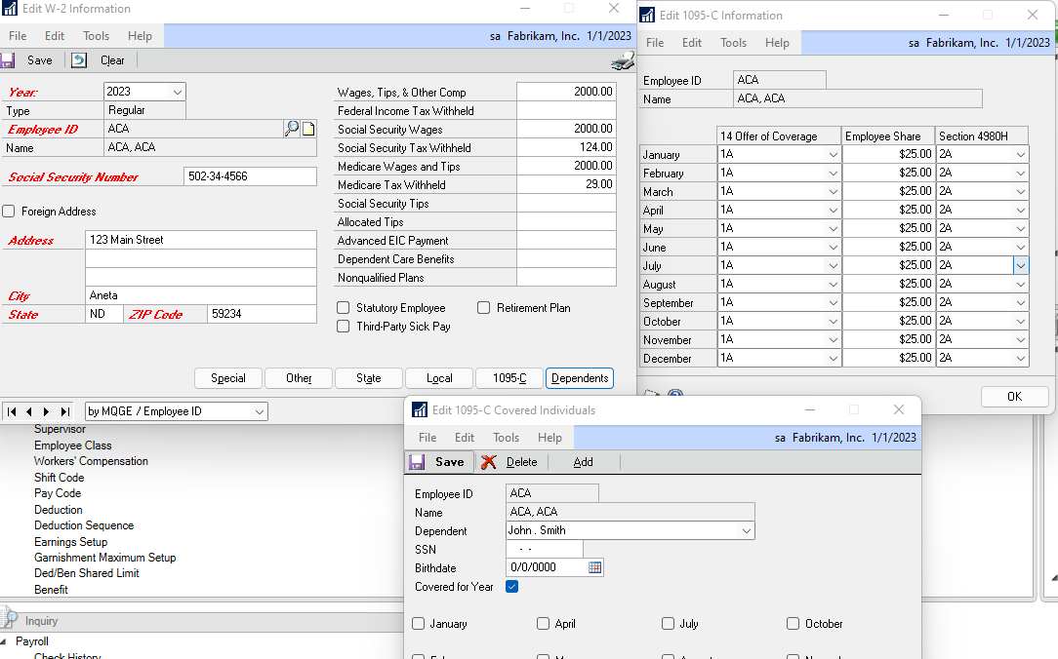
ACA Dynamics GP
Covered all year - dependents
Year-End Editing
Add dependents on fly
Edits lost if recreate year-end
Notes:
https://mbs.microsoft.com/customersource/northamerica/GP/learning/documentation/system-requirements/dynamicsgpresource

Slide 9
ACA Dynamics GP
When you click PRINT for 1095
If employee is 2A all year Line 16
Employee not employed during the month no form prints.
Employees still included in year-end just not printed.
Workaround – script blogs/slide
Inactive employee prints on ACA form - When employee leaves change for ACA
Notes:
delete a from UPR10111 a
inner join UPR10101 b
on a.EMPLOYID = b.EMPLOYID
and a.YEAR1 = b.RPTNGYR
where b.RPTNGYR = '2021'
and b.WGTPCOMP = 0
This removes employees that have no wages in the year, if you are using payroll we assume employees would have wages. Back up's are always recommended.
BLOG
Microsoft Dynamics GP Year-End Update 2021: Affordable Care Act (ACA) - Microsoft Dynamics GP Community

Slide 10
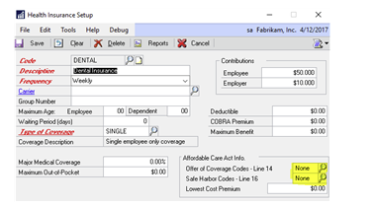
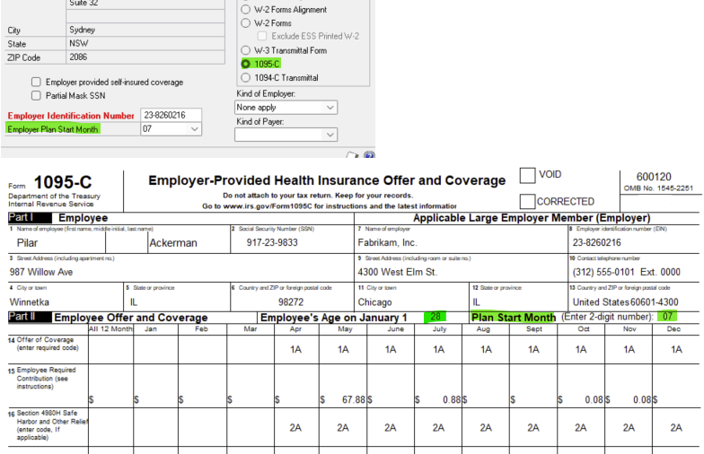
ACA for Microsoft Dynamics GP
Multiple Insurance plans
Plan Start Month
Age
Employer provided Coverage
Mask SSN
All 12 months (not required)

Slide 11
Table Information
As you change ACA information it is stored in
Employee – UPR00905
Dependents – UPR00904
Create the year end wage file compiles date to UPR10110 and UPR10111
Notes:
Changes to Existing GP Tables:
BE020230 - HR Benefit Setup table (HR_Benefit_SETP) had the following fields added:
OfferOfCoverageCode
SafeHarborCode
BE010130 - HR Benefit Master table ( aka HR_Benefit_MSTR) had the following fields added:
OfferOfCoverageCode
SafeHarborCode
New Tables:
UPR40105 - UPR 1095 Setup File
The UPR40105 holds ACA codes and descriptions. You can see the data stored in this table when you open the Affordable Care Act Codes window.
This table is utilized to allow users to fill out boxes that will show on the Federal Government’s 1095 form.
UPR00904 – Payroll Master Dependent ACA
The UPR00904 table stores a record for every dependent associated with each employee.
Things to know about this table:
Health Insurance Dependent Coverage (HealthInsDependentCov) field meaning:
1 = Covered 2 = Not Covered
Dependents are marked as ‘covered’ in this table by default
This information can be updated throughout the year, and is tracked on a monthly basis
UPR00905 – Payroll Master Employee ACA
The UPR00905 table stores Affordable Care Act Codes assigned in the Health Insurance Enrollment window.
ACA Codes can be updated in the Health Insurance Enrollment window.
These codes are tracked monthly throughout the year.

Slide 12
Thank you for watching theley@microsoft.com
For questions, please comment on the Blog Post.
For Product Suggestions please visit: https://ideas.dynamics.com/ideas/

